Slide 1
NAME- ANIKET PHAPALE Project on “CUSTOMER SALES REVENUE” (YEAR 2020-21) (ANALYSIS OF CUSTOMER REVENUE) project link: https://drive.google.com/drive/folders/119_nxqo9jaaM9PBpLxU3etV2Bj-HDkri?usp=sharing

Slide 2
About the project:
The project deals with descriptive analysis of the dataset from Kaggle.com. The project mainly deals with the study of customer sales revenue from year of 2020-21.
The dataset consist of sales transactions recorded during the period of particular dataset include 675 rows and 36 columns .
The study will help startup to compare their current business with the before scenario.this study will also help startup to dive deep and gain insight about their customer base product performance and sales for the past years and the strategize and take decisions accordingly to improve their sales.
Presentation video link: https://drive.google.com/file/d/1pDqYc2SErCX0aWhEPb0xjenHDvGGR9KY/view?usp=sharing

Slide 3
Problem statements: 1.Quarter-wise total quantity ordered. 2.Quantity discount correlation. 3.Region and category-wise total sales revenue. 4.Month-wise total sales revenue. 5.Region-wise quantity ordered and sales revenue. 6.Total sales revenue per state. 7.Age-wise sales analysis. 8.Region-wise revenue share(%). 9.Revenue per category(gender-wise). 10.Dashboard.

Slide 4
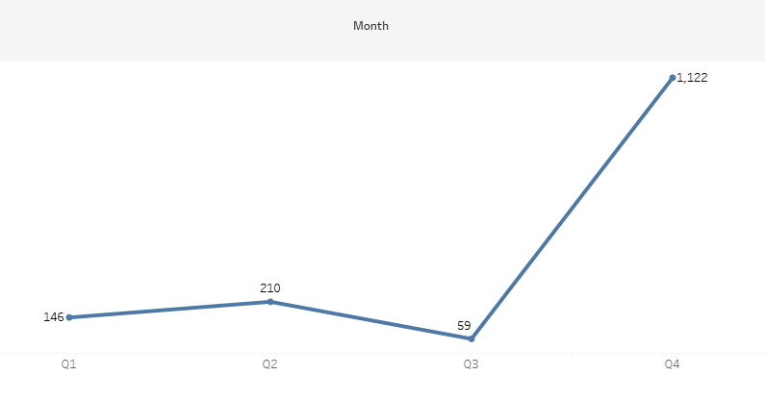
1.Quarter-wise total quantity ordered.
In terms of total sales revenue for total quantity ordered there was 4th quarter most best performing quarter.that is 1122 quantity ordered
In terms of quantity ordered there was quarter 3rd lowest peforming quarter that was 59 quantity orderd.

Slide 5
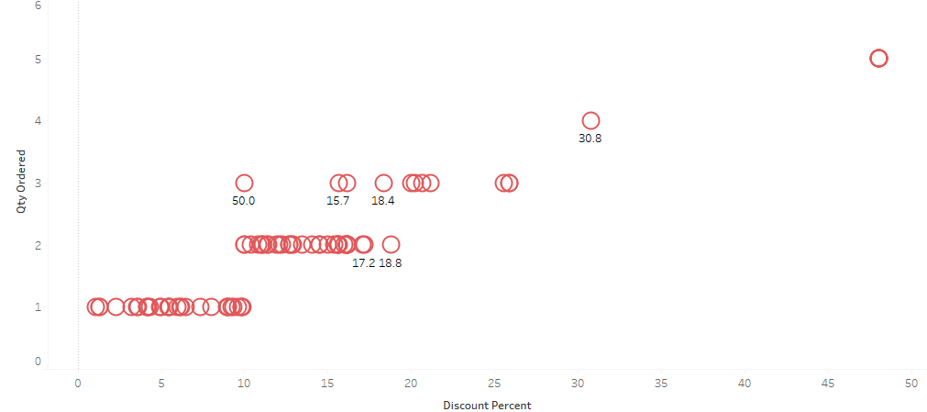
2.Quantity discount correlation.
In this quantity discount correlation
As the discount percent was increasing quantity ordered also increasing.
If the discount percent of product was high the quantity ordered was likely to be high as well.
There was a positive correlation.

Slide 6
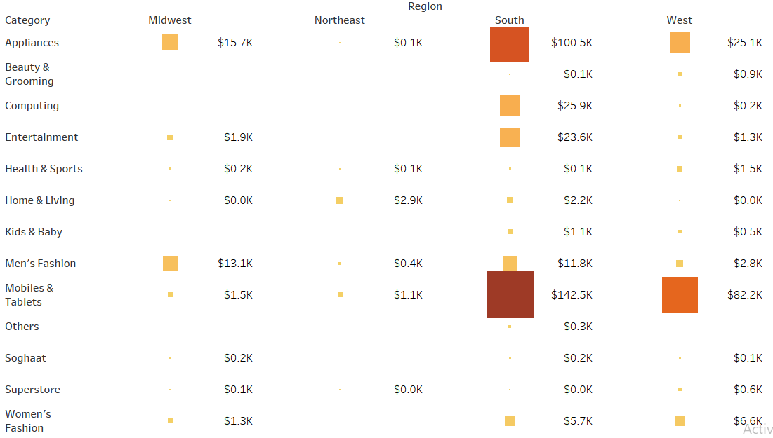
3.Region and category-wise highest sales revenue.
This heat map showing region and category wise total sales revenue.
there was in south region mobile and tablets are top most sales revenue category product which was $142.5k.

Slide 7
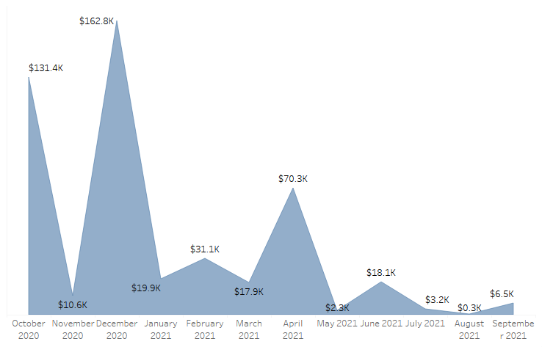
4.Month-wise total sales revenue.
This area chart showing month-wise total sales revenue.
In the December 2020 there was highest sales revenue which was $162.8k and November 2020 was lowest sales revenue.
In the April 2021 there was highest sales revenue which was $70.3k and august 2021 was lowest sales revenue which was $0.3k.

Slide 8
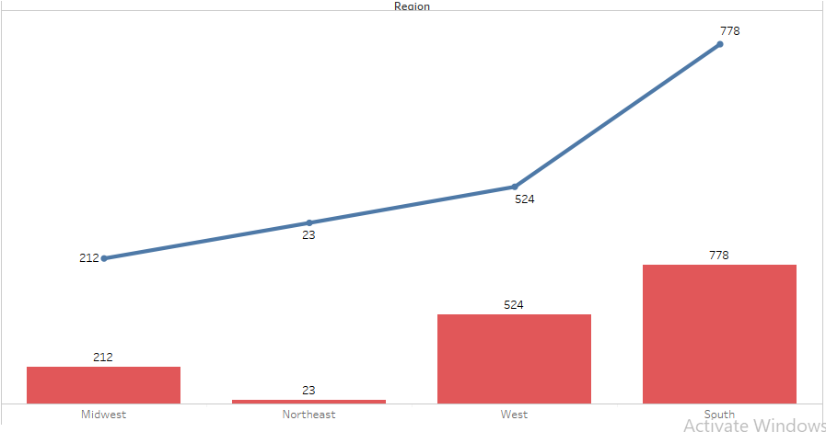
5.Region-wise quantity ordered and sales revenue.
This dual axis chart showing region wise quantity ordered and sales revenue.
In south region there was highest quantity ordered and top most sales revenue.
As compare to there was northeast region was lowest performance with respect to sales revenue and quantity ordered.

Slide 9
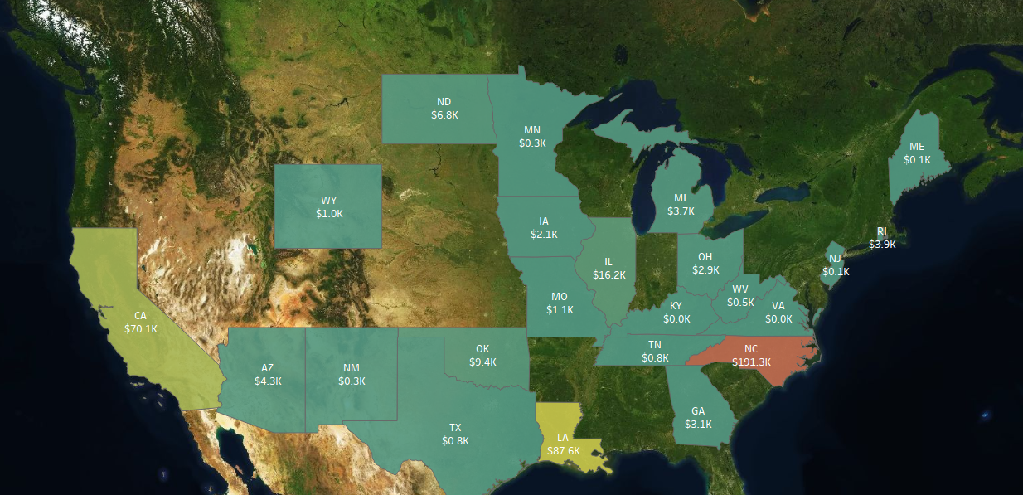
6.Total sales revenue per state.
This map showing total sales revenue per state
In the “NC” state there was highest sales revenue.

Slide 10
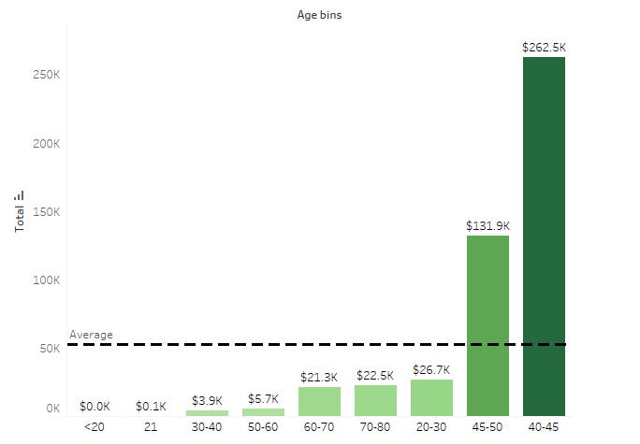
7.Age-wise sales analysis
The age between 40-45 there was highest sales revenue
Refrence line showing average sales revenue wich was $52.7k

Slide 11
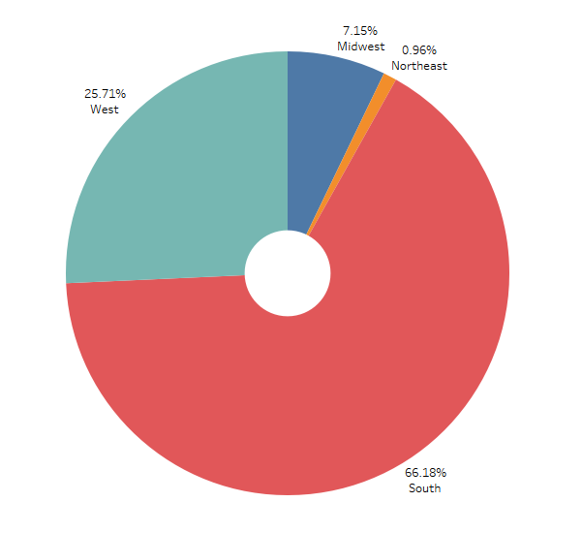
8.Region-wise revenue share(%).
This donut chart showing region-wise revenue share.
In south region there was highest sales revenue wich was 66.18%

Slide 12
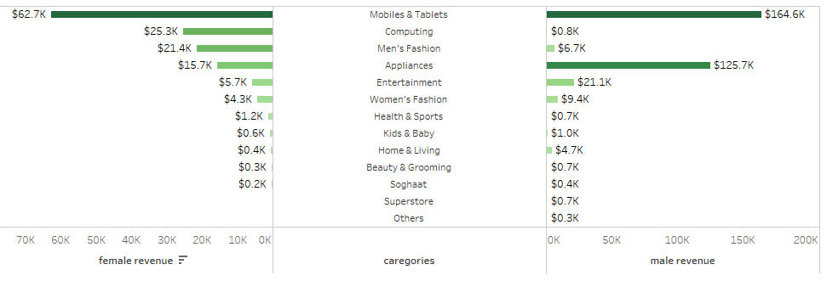
9.Revenue per category(gender-wise).
In this chart concluded female and male revenue with respect to categories.
Mobiles and tablets category was highest revenue in male and female also.

Slide 13
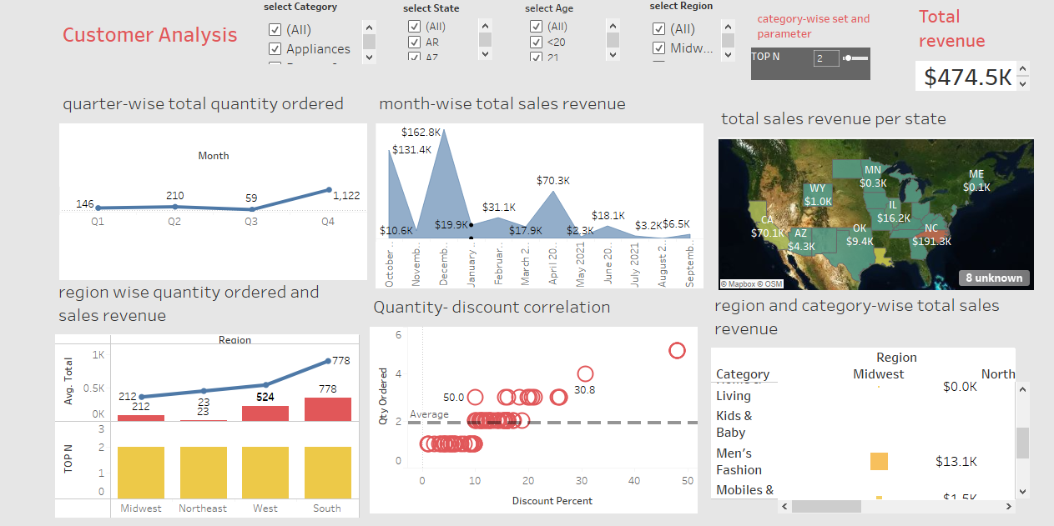
10.Dashboard (Analysis of customer revenue)

Slide 14
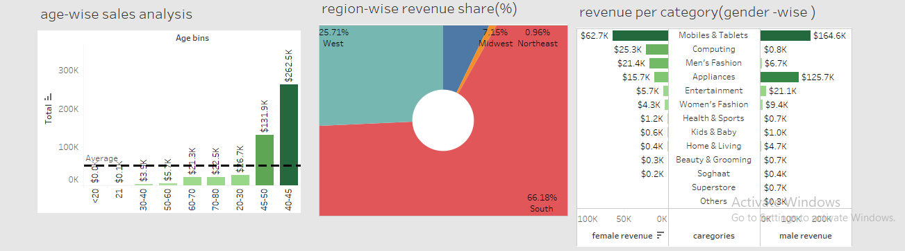

Slide 15
conclusion:
From the study of customer sales revenue in year of 2020 and 2021 there was total revenue is $474.5k .
In year of 2020 there was highest sales revenue. Which was $304.9k.
In year of 2021 there was lowest sales revenue which was $169.6k.
Highest revenue in south region and product category was mobiles and tablets.

Slide 16
Project link: https://drive.google.com/drive/folders/119_nxqo9jaaM9PBpLxU3etV2Bj-HDkri?usp=sharing
Presentation video link:
https://drive.google.com/file/d/1pDqYc2SErCX0aWhEPb0xjenHDvGGR9KY/view?usp=sharing

Slide 17
THANK YOU…

